Slide 1
Progress Report
5/6
HJ. Kwon
Progress Report
NCC-GCSP

Slide 2
Table 1-a. Baseline characteristics of the male and female Patients subject to liver cancer screening in 2009
HJ. Kwon
Progress Report
NCC-GCSP

Slide 3
Table 1-b. Family History of Patients subject to liver cancer screening in 2009 (2006~2009)
HJ. Kwon
Progress Report
NCC-GCSP

Slide 4
Table 2. DM and LVC by point of time of Patients subject to liver cancer screening in 2009
HJ. Kwon
Progress Report
NCC-GCSP

Slide 5
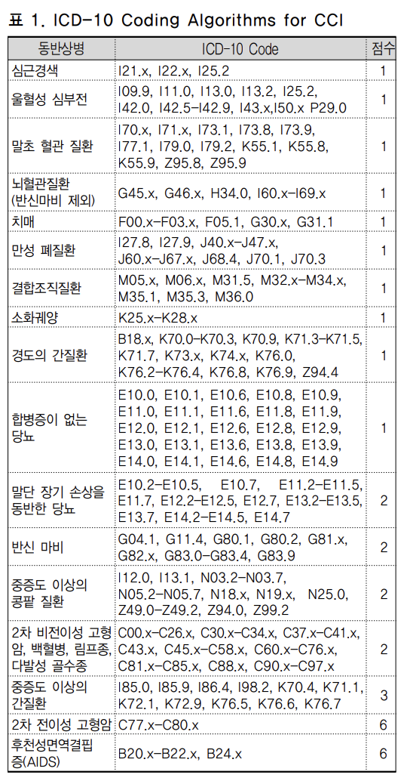
추가사항
HJ. Kwon
Progress Report
NCC-GCSP

Slide 6
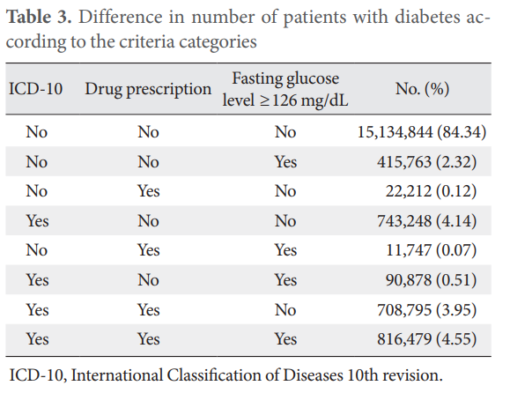
추가사항
HJ. Kwon
Progress Report
NCC-GCSP

Slide 7
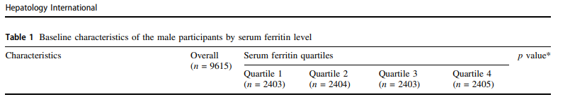
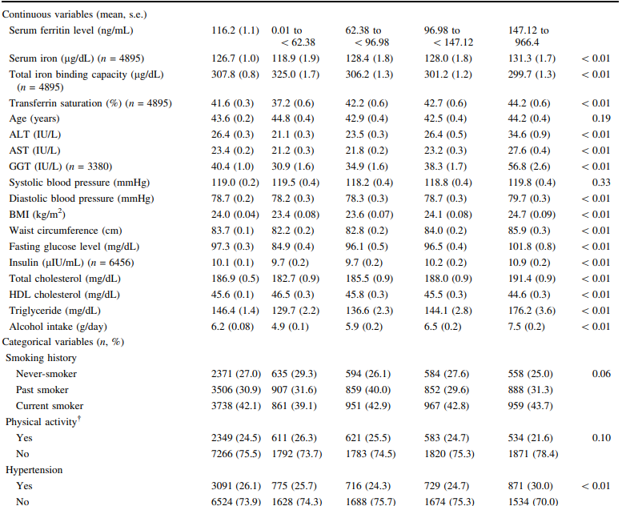
추가사항
HJ. Kwon
Progress Report
NCC-GCSP

Slide 8
Thanks you
HJ. Kwon
Progress Report
NCC-GCSP

